Slide 1
Wavelength
Med-fi Prototyping
Team 2: Connor, Corbin, Sebastian, Steven

Slide 2
Overview
Mission Statement and Value Proposition
Problem/Solution Overview
Revised Interface
Med-Fi Prototype
User Testing

Slide 3

Mission Statement
Value Proposition
Our aim with Wavelength is make it easier for people with similar music tastes to connect. We believe music is better when you share it with others!
Connecting compatible music listeners.

Slide 4
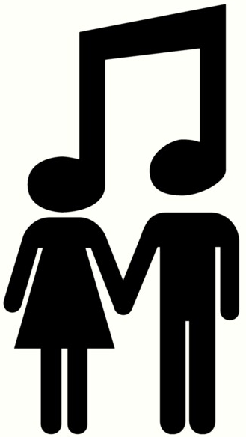
Problem/Solution Overview
It can be difficult to find friends with the same taste in music. There is a vast pool of musical genres and artists, AND growing number of ways to consume music.
Our solution, Wavelength, is a platform where users are matched with one another based on sampled music taste and geographical proximity. We encourage users to chat about their music taste, share songs with each other, or even meet in real life and go to a concert together.
Important distinction to be made: Wavelength is NOT a competitor to music streaming or purchasing platforms.

Slide 5
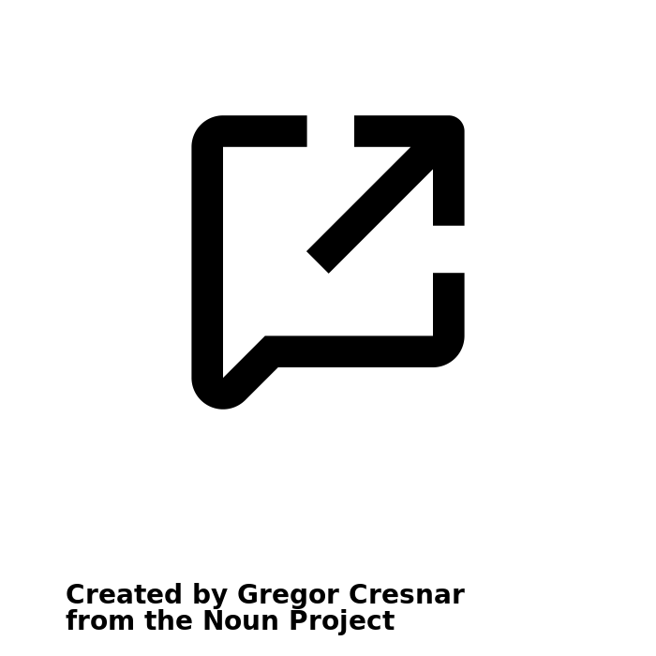
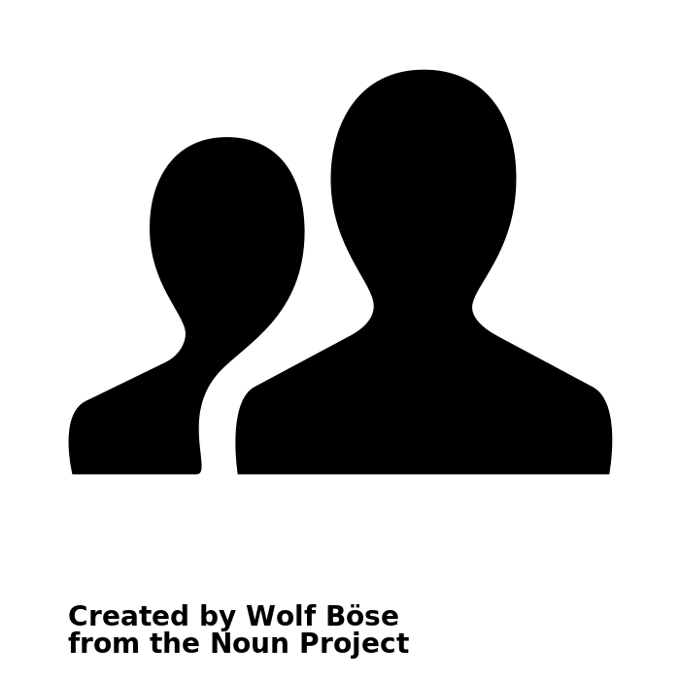
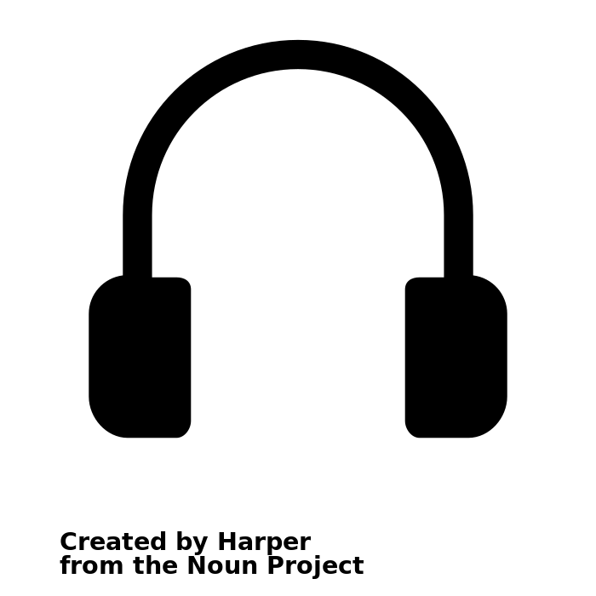
Tasks
Simple
Medium
Complex
Create a profile
View a friend’s profile
Add song to live listening session with a friend

Slide 6
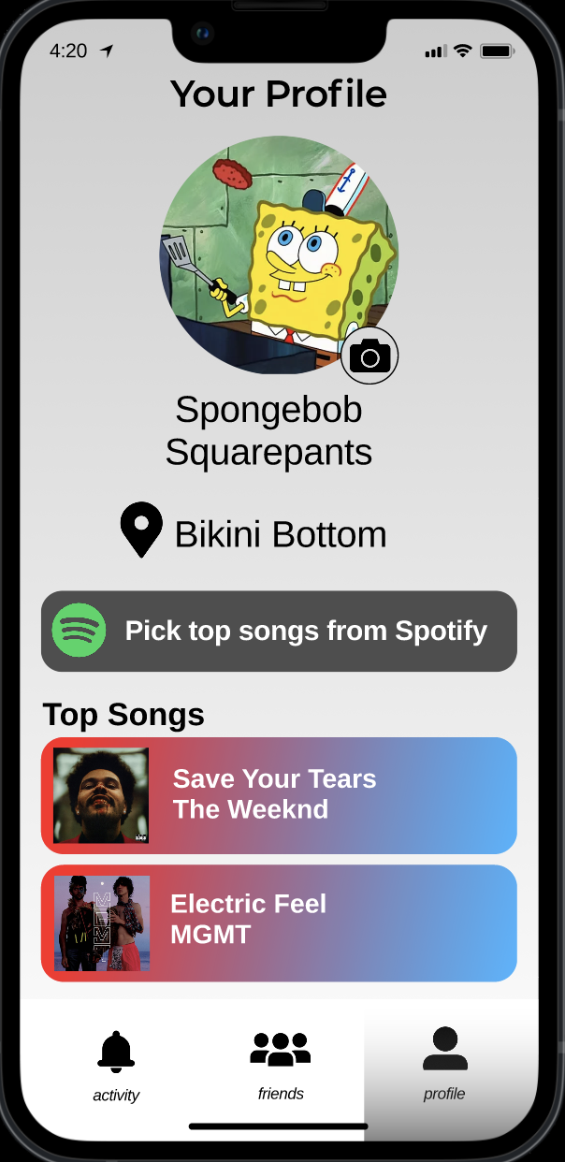
Simple Task: Create a Profile

Slide 7
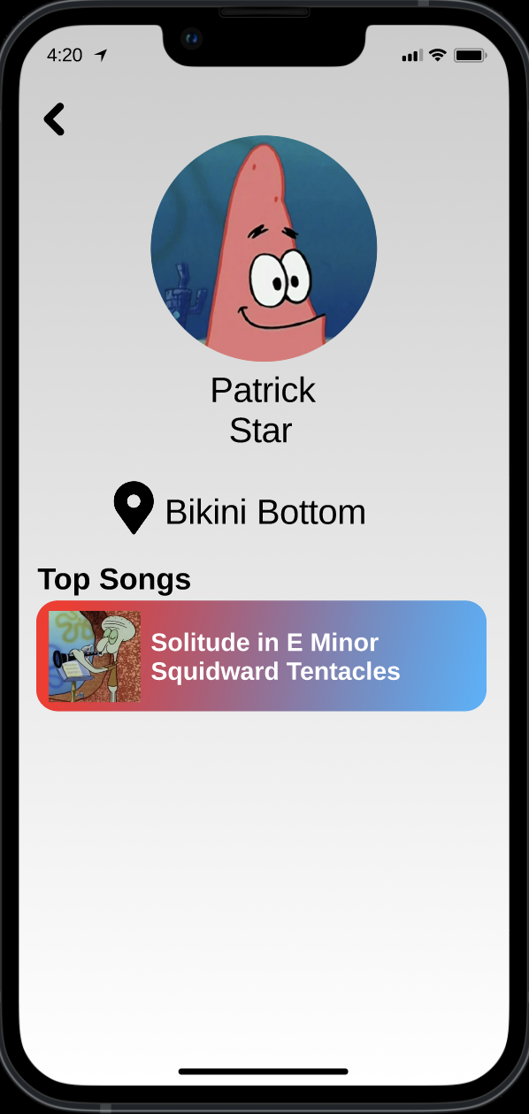
Moderate Task: View a friend’s profile

Slide 8
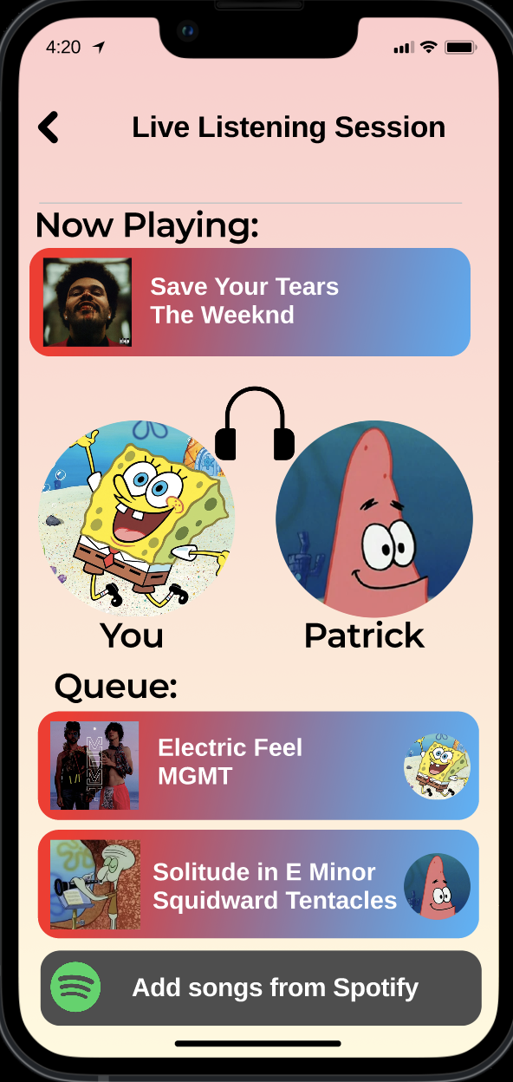
Complex Task: Add a song to listening session with a friend

Slide 9
Usability Goals
Our main usability goals were to have each participant complete each task quickly and easily without becoming confused by the app or needing to ask the facilitator questions.

Slide 10
Key Measures
We focused on how easily users were able to complete the three tasks. When users found navigating the app confusing, we asked what they were struggling with in order to target pain points. To obtain a quantitative measurement about the simplicity of our UI, we timed each participant while they completed the tasks.

Slide 11
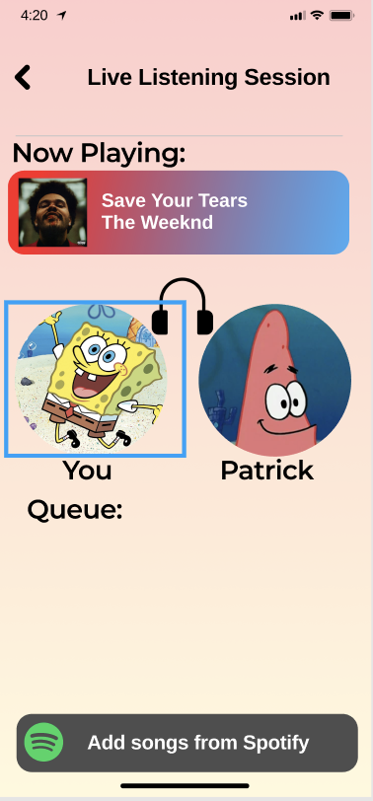
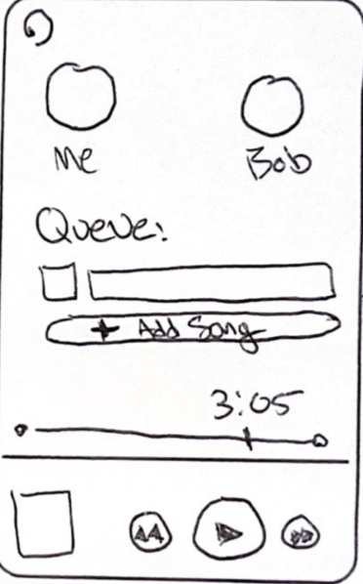
Revised Interface Design
-Enhanced design appeal
-Easy and user friendly way to add songs from music app
- More in depth user-to-user display

Slide 12
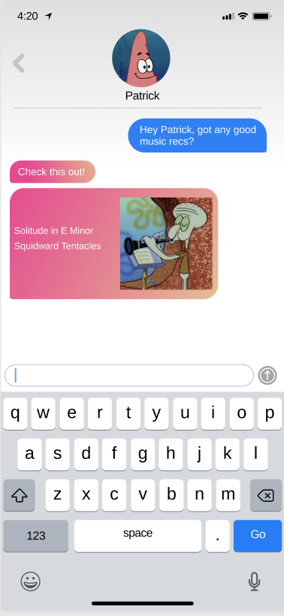
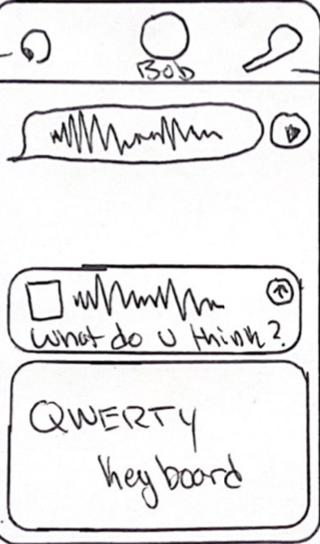
Revised Interface Design
-Sending songs and messaging far more fleshed out
-Simplified navigation options

Slide 13
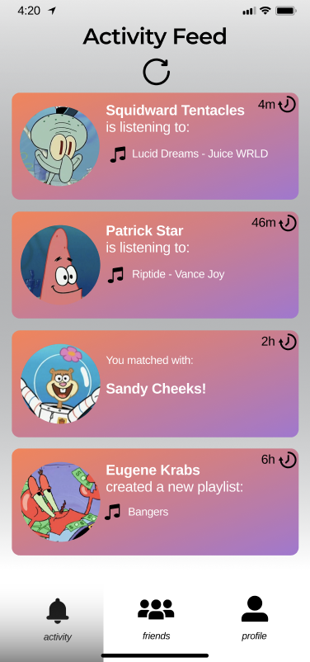
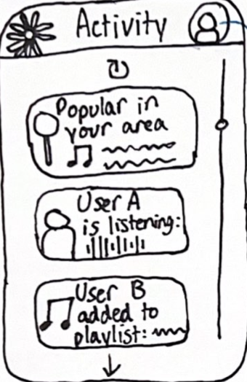
Revised Interface Design
-Far more uniform activity feed
-Page navigation at bottom to improve distribution
- All activity user aligned

Slide 14
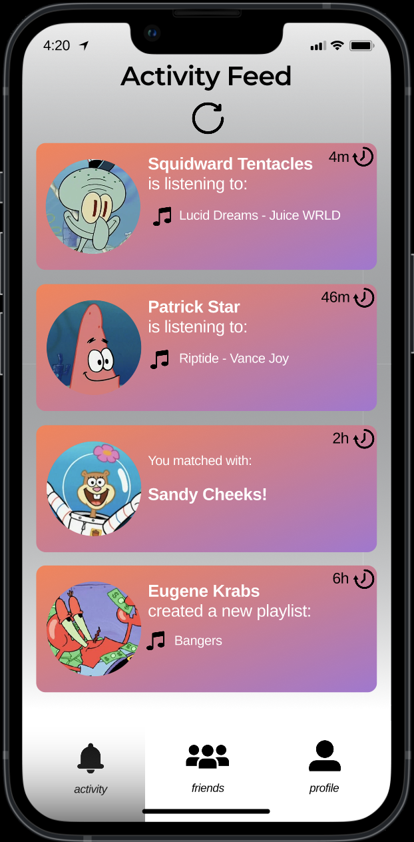
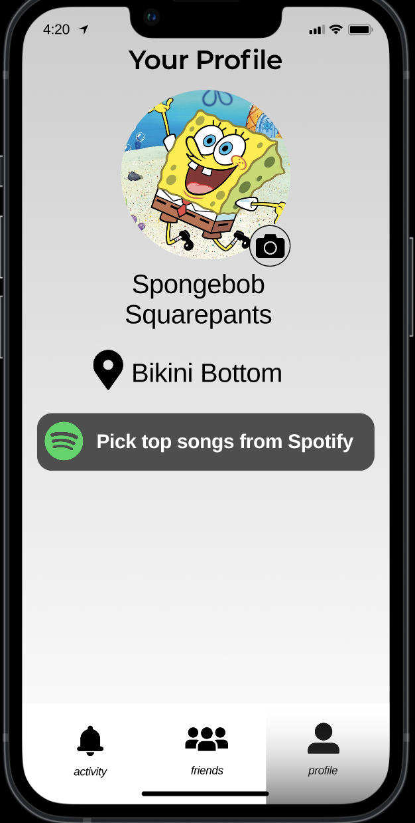
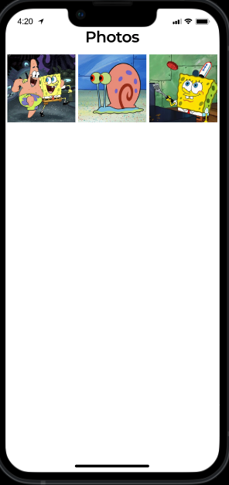
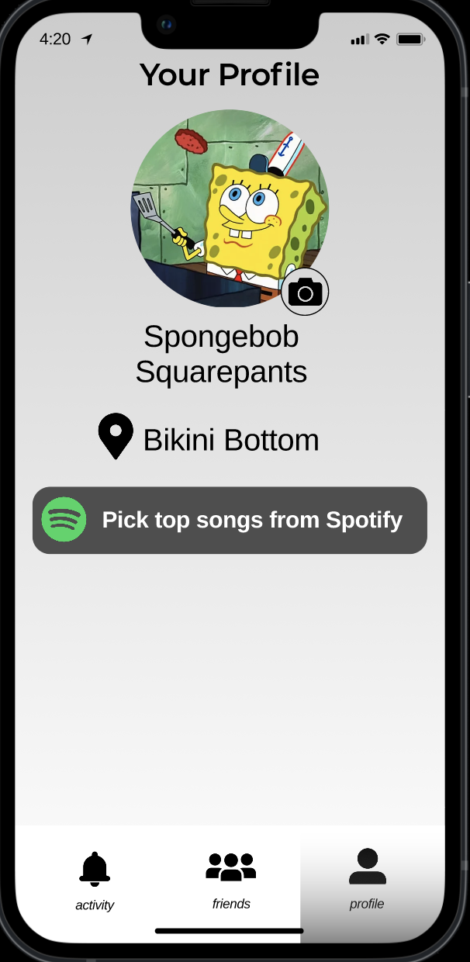
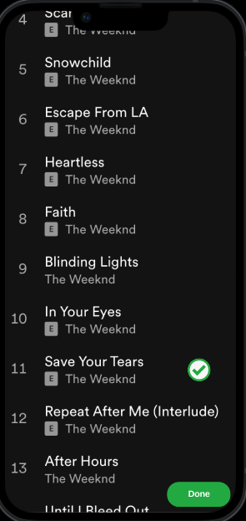
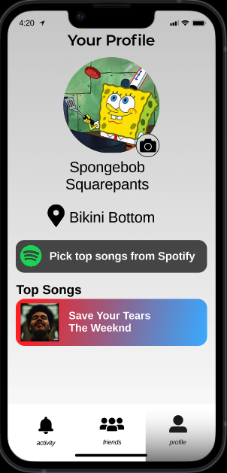
Easy Task Flow: Customize your Profile
This task flow starts by clicking on the profile tab, then customizing a profile picture and top songs to be displayed!

Slide 15
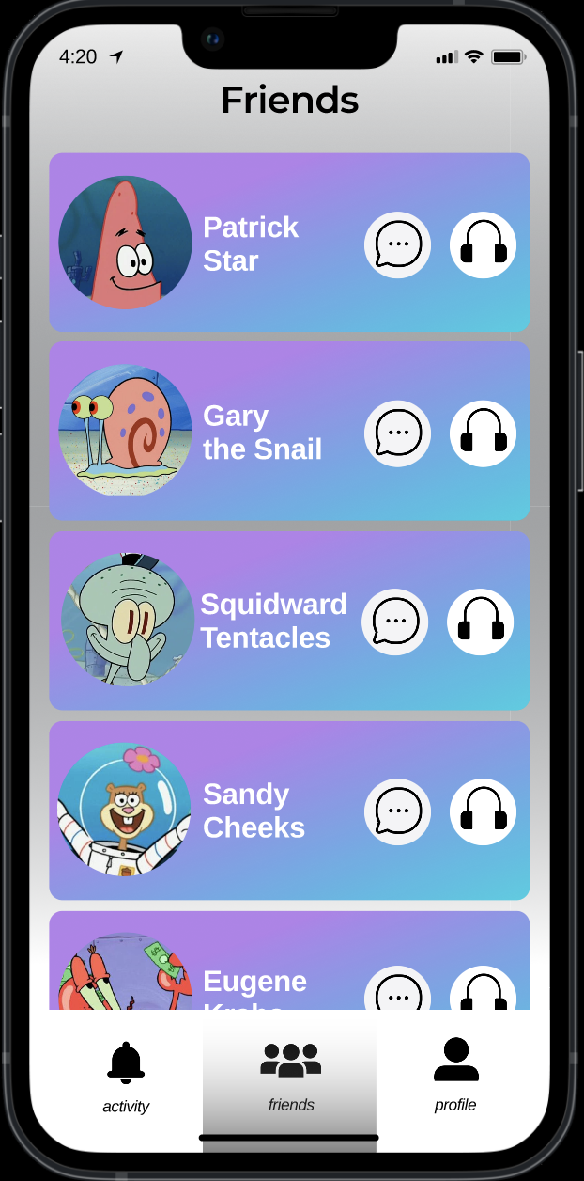
Medium Task Flow: View a friend’s profile
To access a friends profile, a user clicks on the friends tab and selects the profile icon of the friend they want to see

Slide 16
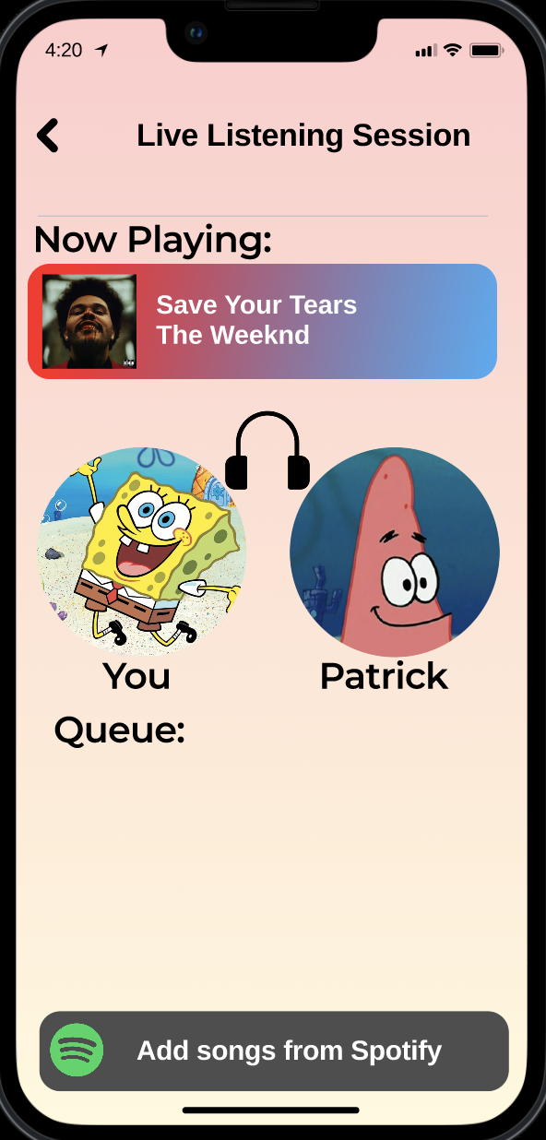
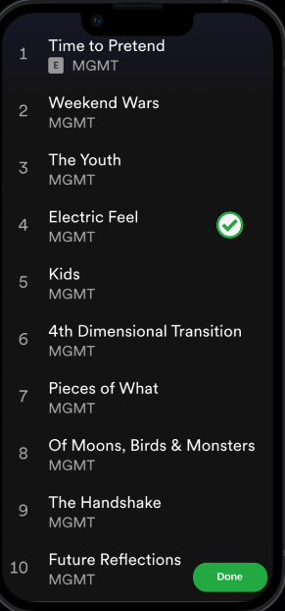
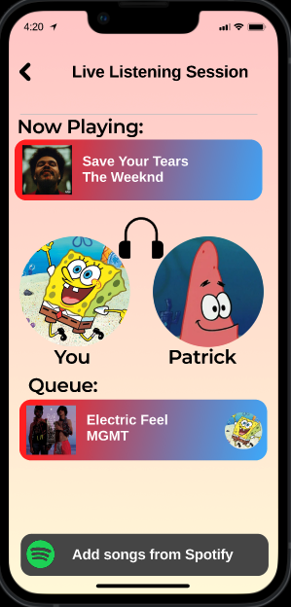
Hard Task Flow: Add a song to a live listening session
To add to the live listening queue, the user goes to the friends tab, clicks the headphone icon, then adds songs to queue from spotify which are then displayed in the queue!

Slide 17
Prototype Overview

Slide 18
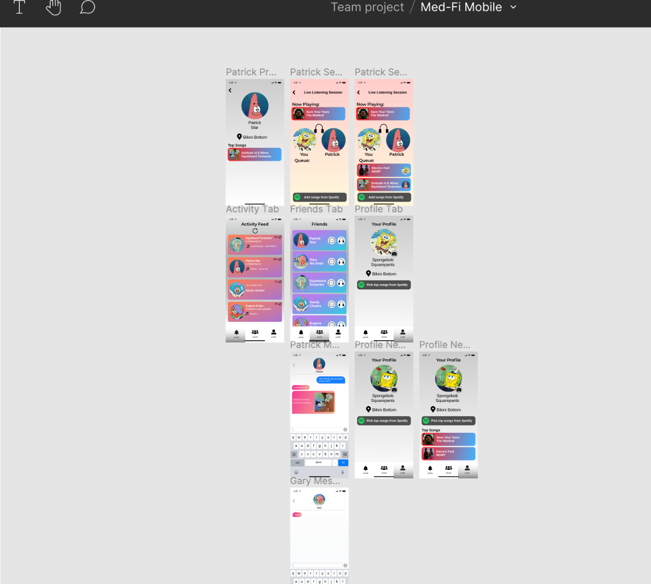
Tools
Our prototype was designed, constructed, and operated using Figma.
Allowed for comprehensive prototyping
Steeper learning curve than MarvelApp
Easy collaboration

Slide 19
Limitations
No actual music listening during prototype
Arguably most pivotal appeal factor of app
No explanation of user matching process
Customizability somewhat limited

Slide 20
Constraints
No ‘Wizard of Oz’ techniques were needed, the prototyping tool in Figma was sufficient
Certain flows hard-coded due to difficulty of implementing
Custom chat interaction, song exchanging, profile customization
Only particular task flows are available to prototype tester, rather than more realistic exploration

Slide 21
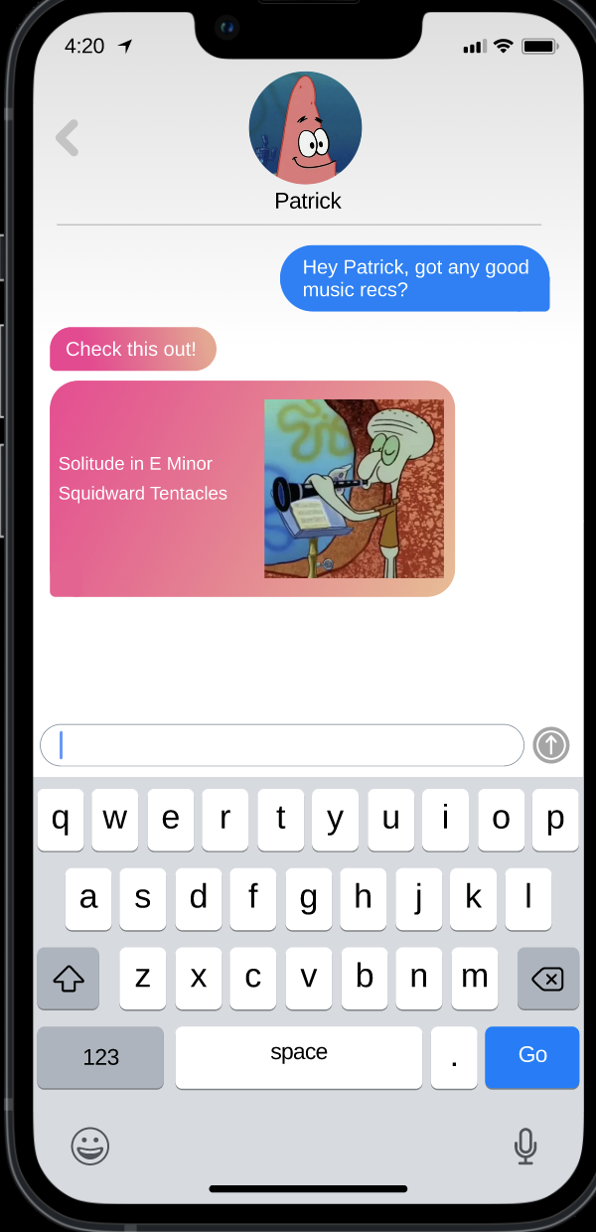
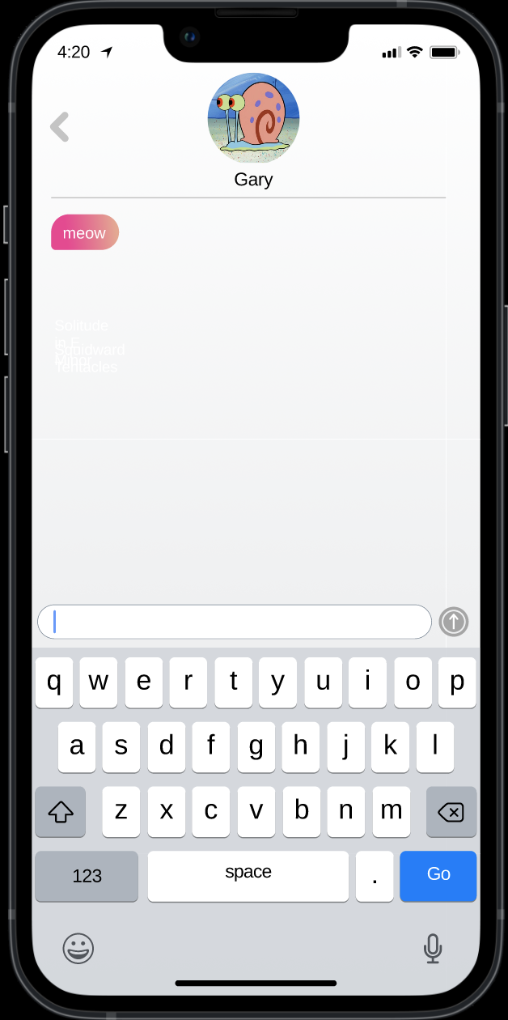
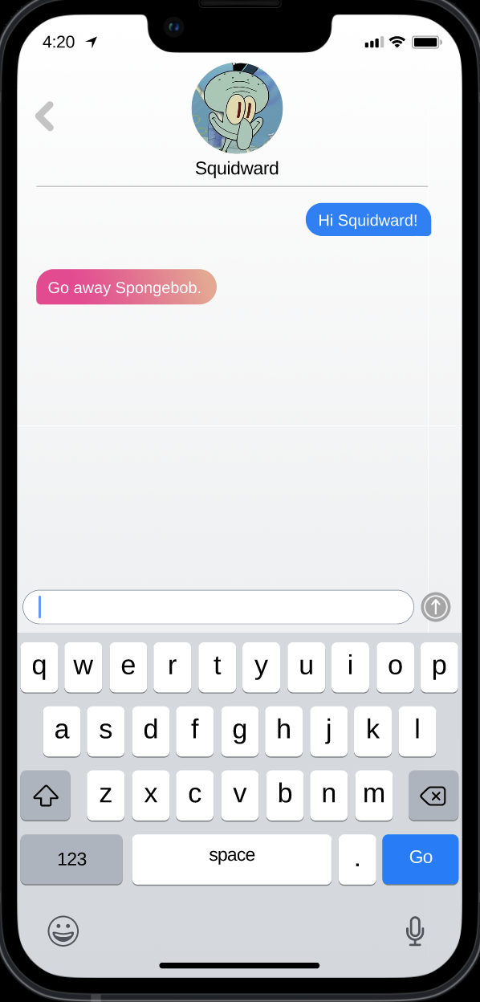
Additional Screenshots: Chat Functionality
The chat function will be simple, allowing users to message friends and send songs through connecting to music streaming apps.

Slide 22
Summary

Slide 23
Our aim with Wavelength is make it easier for people with similar music tastes to connect. We believe music is better when you share it with others!

Slide 24
“Connecting compatible music listeners”
Wavelength

Slide 25
Thank You!

Slide 26



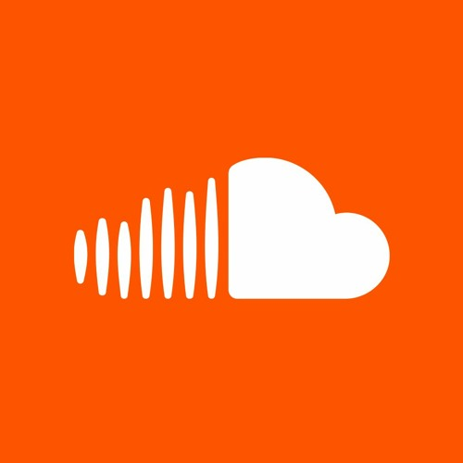





WAVELENGTH
Finding People
Finding Music

Slide 27
